Slide 1
College Technical Math 1
Section 10.1
Solving Systems of Two Variable Linear Equations - Graphing

Slide 2
System of Equations
A system of equations is a set of two or more equations.
$$−2x+3y=−18$$
$$x−2y+z=9$$
$$x+5y=−10$$
$$−3x+5y−3z=5$$
$$2x+y−z=−4$$

Slide 3
System of Equations
A solution to a system of equations is an ordered pair, $(x,y)$, or ordered triplet, $(x,y,z)$, that is a solution to each equation in the system.
The solution to a system of equations is therefore a point of intersection between the graphs of the equations in the system.

Slide 4
System of Equations
Is $(3,−2)$ a solution to the system of equations $x−3y=9$ and $y=\frac{2}{3}x−4$? (Example)
Check for equation 1:
$$x−3y=9$$

Slide 5
System of Equations
Is $(3,−2)$ a solution to the system of equations $x−3y=9$ and $y=\frac{2}{3}x−4$? (Example)
Check for equation 1:
$$x−3y=9$$
$$3−3y=9$$

Slide 6
System of Equations
Is $(3,−2)$ a solution to the system of equations $x−3y=9$ and $y=\frac{2}{3}x−4$? (Example)
Check for equation 1:
$$x−3y=9$$
$$3−3(−2)=9$$

Slide 7
System of Equations
Is $(3,−2)$ a solution to the system of equations $x−3y=9$ and $y=\frac{2}{3}x−4$? (Example)
Check for equation 1:
$$x−3y=9$$
$$3−3(−2)=9$$
$$9=9$$

Slide 8
System of Equations
Is $(3,−2)$ a solution to the system of equations $x−3y=9$ and $y=\frac{2}{3}x−4$? (Example)
Check for equation 1:
Check for equation 2:
$$x−3y=9$$
$y=\frac{2}{3}x−4$
$$3−3(−2)=9$$
$$9=9$$

Slide 9
System of Equations
Is $(3,−2)$ a solution to the system of equations $x−3y=9$ and $y=\frac{2}{3}x−4$? (Example)
Check for equation 1:
Check for equation 2:
$$x−3y=9$$
$y=\frac{2}{3}x−4$
$$3−3(−2)=9$$
$y=\frac{2}{3}(3)−4$
$$9=9$$

Slide 10
System of Equations
Is $(3,−2)$ a solution to the system of equations $x−3y=9$ and $y=\frac{2}{3}x−4$? (Example)
Check for equation 1:
Check for equation 2:
$$x−3y=9$$
$y=\frac{2}{3}x−4$
$$3−3(−2)=9$$
$−2=\frac{2}{3}(3)−4$
$$9=9$$

Slide 11
System of Equations
Is $(3,−2)$ a solution to the system of equations $x−3y=9$ and $y=\frac{2}{3}x−4$? (Example)
Check for equation 1:
Check for equation 2:
$$x−3y=9$$
$y=\frac{2}{3}x−4$
$$3−3(−2)=9$$
$−2=\frac{2}{3}(3)−4$
$$9=9$$
$$−2=−2$$

Slide 12
System of Equations
Is $(3,−2)$ a solution to the system of equations $x−3y=9$ and $y=\frac{2}{3}x−4$? (Example)
Since the ordered pair $(3,−2)$ is a solution to both equations, $(3,−2)$ is a solution to the system of equations $x−3y=9$ and $y=\frac{2}{3}x−4$.

Slide 13
System of Equations
Is $(−4,1)$ a solution to the system of equations $3x+2y=−10$ and $3y−4x=12$? (Example)
Check for equation 1:
$$3x+2y=−10$$

Slide 14
System of Equations
Is $(−4,1)$ a solution to the system of equations $3x+2y=−10$ and $3y−4x=12$? (Example)
Check for equation 1:
$$3x+2y=−10$$
$$3(−4)+2y=−10$$

Slide 15
System of Equations
Is $(−4,1)$ a solution to the system of equations $3x+2y=−10$ and $3y−4x=12$? (Example)
Check for equation 1:
$$3x+2y=−10$$
$$3(−4)+2(1)=−10$$

Slide 16
System of Equations
Is $(−4,1)$ a solution to the system of equations $3x+2y=−10$ and $3y−4x=12$? (Example)
Check for equation 1:
$$3x+2y=−10$$
$$3(−4)+2(1)=−10$$
$$−10=−10$$

Slide 17
System of Equations
Is $(−4,1)$ a solution to the system of equations $3x+2y=−10$ and $3y−4x=12$? (Example)
Check for equation 1:
Check for equation 2:
$$3x+2y=−10$$
$$3y−4x=12$$
$$3(−4)+2(1)=−10$$
$$−10=−10$$

Slide 18
System of Equations
Is $(−4,1)$ a solution to the system of equations $3x+2y=−10$ and $3y−4x=12$? (Example)
Check for equation 1:
Check for equation 2:
$$3x+2y=−10$$
$$3y−4x=12$$
$$3(−4)+2(1)=−10$$
$$3y−4(−4)=12$$
$$−10=−10$$

Slide 19
System of Equations
Is $(−4,1)$ a solution to the system of equations $3x+2y=−10$ and $3y−4x=12$? (Example)
Check for equation 1:
Check for equation 2:
$$3x+2y=−10$$
$$3y−4x=12$$
$$3(−4)+2(1)=−10$$
$$3(1)−4(−4)=12$$
$$−10=−10$$

Slide 20
System of Equations
Is $(−4,1)$ a solution to the system of equations $3x+2y=−10$ and $3y−4x=12$? (Example)
Check for equation 1:
Check for equation 2:
$$3x+2y=−10$$
$$3y−4x=12$$
$$3(−4)+2(1)=−10$$
$$3(1)−4(−4)=12$$
$$−10=−10$$
$$19≠12$$

Slide 21
System of Equations
Is $(−4,1)$ a solution to the system of equations $3x+2y=−10$ and $3y−4x=12$? (Example)
Since the ordered pair $(−4,1)$ is not a solution to both equations, $(−4,1)$ is not a solution to the system of equations $3x+2y=−10$ and $3y−4x=12$.

Slide 22
System of Equations
There are several different methods that can be used to solve a system of equations. In this course we will learn:
Solving a system using graphing
Solving a system using substitution
Solving a system using elimination(addition)

Slide 23
System of Equations
Just like a linear equation, a system of equations may have:
One solution
No solution
An infinite number of solutions
As we go through the various methods of solving a system of equations, I will point out each case.

Slide 24
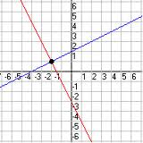
Solving Using Graphing
To solve a system of equations using graphing, graph each equation on the same rectangular coordinate plane and then identify the point of intersection of the graphs.

Slide 25
Solving Using Graphing
Solve $2x−y=6$ and $y=−\frac{3}{4}x+5$ using graphing. (Example)

Slide 26
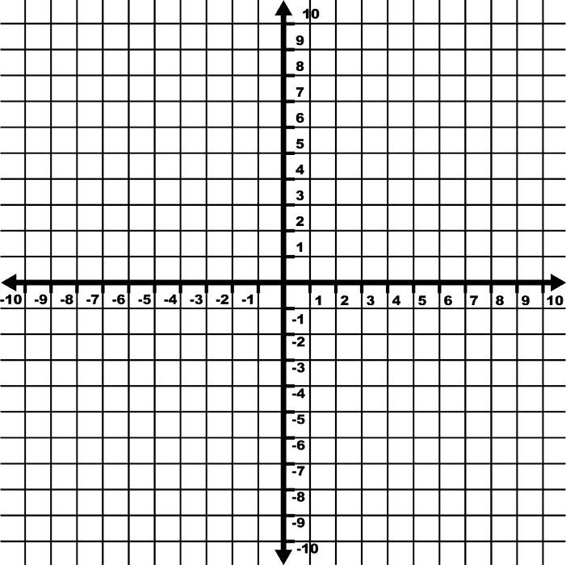
Solving Using Graphing
Solve $2x−y=6$ and $y=−\frac{3}{4}x+5$ using graphing. (Example)

Slide 27
Solving Using Graphing
Solve $2x−y=6$ and $y=−\frac{3}{4}x+5$ using graphing. (Example)

Slide 28
Solving Using Graphing
Solve $2x−y=6$ and $y=−\frac{3}{4}x+5$ using graphing. (Example)
$$Solution: (4,2)$$

Slide 29
Solving Using Graphing
Solve $−3x+2y=12$ and $y=\frac{3}{2}x−7$ using graphing. (Example)

Slide 30
Solving Using Graphing
Solve $−3x+2y=12$ and $y=\frac{3}{2}x−7$ using graphing. (Example)

Slide 31
Solving Using Graphing
Solve $−3x+2y=12$ and $y=\frac{3}{2}x−7$ using graphing. (Example)

Slide 32
Solving Using Graphing
Solve $−3x+2y=12$ and $y=\frac{3}{2}x−7$ using graphing. (Example)
The lines are parallel and don’t intersect.
This system of equations has no solution.

Slide 33
Solving Using Graphing
Solve $4x−4y=−12$ and $y=x+3$ using graphing. (Example)

Slide 34
Solving Using Graphing
Solve $4x−4y=−12$ and $y=x+3$ using graphing. (Example)

Slide 35
Solving Using Graphing
Solve $4x−4y=−12$ and $y=x+3$ using graphing. (Example)

Slide 36
Solving Using Graphing
Solve $4x−4y=−12$ and $y=x+3$ using graphing. (Example)
This system of equations has an infinite number of solutions.
Both equations describe the same line.

Slide 37
Solving Using Graphing
Reminder, the graph of $y=b$, is a horizontal line that has a y-intercept of $(0,b)$.
$$y=5$$
$$y=−2$$

Slide 38
Solving Using Graphing
Reminder, the graph of $x=a$, is a vertical line that has a x-intercept of $(a,0)$.
$$x=−7$$
$$x=3$$

